Slide 1
Welcome to ReDI
Berlin Fall/Autumn 2024

Slide 2
📹
Recording Check!

Slide 3
Today
1. Meet your teachers
2. Define your Working Alliance
3. Intro to the course

Slide 4
Ice Breaker
Notes:
Format everyone stands and moves to find someone new
Find someone you don’t know very well
Switch to a new person:
Who are you and:
What was your favorite childhood game?
Switch to a new person:
Who are you and:
What are your best talents?
Switch to a new person:
Who are you and:
What is your idea for the next great invention?
Switch to a new person:
Who are you and:
What is a fun fact not many people know?

Slide 5
Hello from the teachers
Notes:
ASK THE TEACHERS TO Introduce themselves
Name
Where you work
What you work as

Slide 6


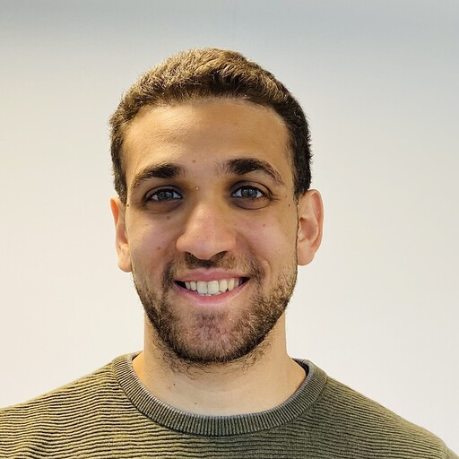


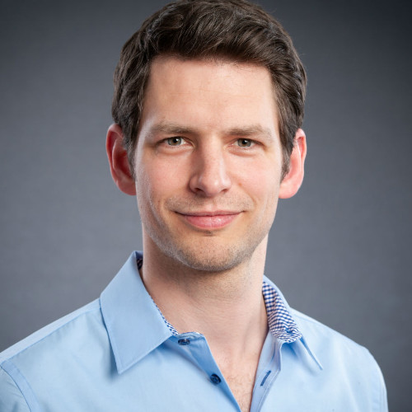
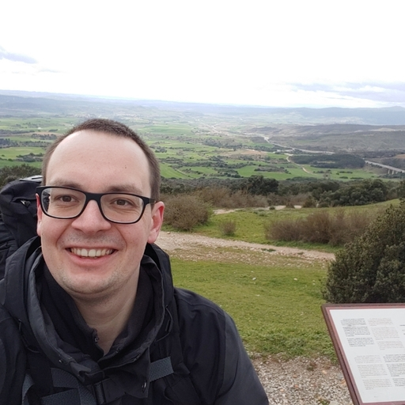

MEET THE TEACHERS
Nathan
Azad
Youssef
Guneş
Kateryna
Mortiz
Timo

Slide 7
Working alliance
Notes:
Why are we talking about working alliance?
Give a short intro to the Course culture doc

Slide 8
Keep focus
Respect our time
Create spaces for inquiry
Be kind and brave
Be mindful of the space you take up
Look for the learnings
Notes:
ReDI School Safe Space guidelines
Will be written on the flip chart to start with
Keep focus: we stay focused on our personal and group learning aims.
Respect our time: let’s be punctual for arrival and after breaks so that we can start on time.
Create spaces for inquiry: we encourage all questions, we learn through asking questions and it is likely on someone else’s mind too if it’s your question! Let’s allow for any kind of question.
Be kind and brave: we take care of each other in this learning environment and treat each other kindly and with respect whilst also stepping out of our comfort zone and into an active learning zone.
Be mindful of the space you take up: we aim to allow space for our voices to be heard as a group. It’s normal that some of us enjoy public speaking more than others. Let us find ways to give space for everyone to be heard, in group conversations, pairwork and in our larger setting.
Look for the learnings: we will face moments when we are feeling challenged, there will most likely always be a learning. Ask for support when you need it and embrace the learnings that come.

Slide 9
Set the working alliance!
Notes:
Groups of 4-5 people gather to discuss these questions

Slide 10


What is important to you when working together?
ⓘ
Click Present with Slido or install our Chrome extension to activate this poll while presenting.
Notes:
📣 This is Slido interaction slide, please don't delete it. ✅ Click on 'Present with Slido' and the poll will launch automatically when you get to this slide.

Slide 11

Bonus task: formulate your definition of working alliance as an actionable sentence.
ⓘ
Click Present with Slido or install our Chrome extension to activate this poll while presenting.
Notes:
📣 This is Slido interaction slide, please don't delete it. ✅ Click on 'Present with Slido' and the poll will launch automatically when you get to this slide.

Slide 12
Your working alliance
Sharing knowledge and experience builds trust and respect which benefits all of us.
Improving team work ability and cooperate each other is known as working alliance.
We are here to learn from each other in a friendly atmosphere.
Having a friendly environment to help share ideas.
A working alliance is defined by mutual trust and commitment to achieve the desired goals.
A collaborative mutualism focused on achieving objectives with communication.
Establish and maintain a respectful and timely working environment with clearly set goals.
Working alliance is a system of values shared by team members.
working towards clearly defined and common goals.
Working together with respect to a common goal.
Stick to the important stuff. Patient is good but not waste time
Notes:
Groups of 4-5 people gather to discuss these questions

Slide 13
Intro to the course
Machine Learning & AI
Notes:
Learning goals
Learner timeline
Project phase (small mention)
Important tools
Communication
Location & format

Slide 14

Which programming language is commonly used in machine learning?
ⓘ
Click Present with Slido or install our Chrome extension to activate this poll while presenting.
Notes:
📣 This is Slido interaction slide, please don't delete it. ✅ Click on 'Present with Slido' and the poll will launch automatically when you get to this slide.

Slide 15

In Machine Learning, which of these is most important to keep in mind?
ⓘ
Click Present with Slido or install our Chrome extension to activate this poll while presenting.
Notes:
📣 This is Slido interaction slide, please don't delete it. ✅ Click on 'Present with Slido' and the poll will launch automatically when you get to this slide.

Slide 16
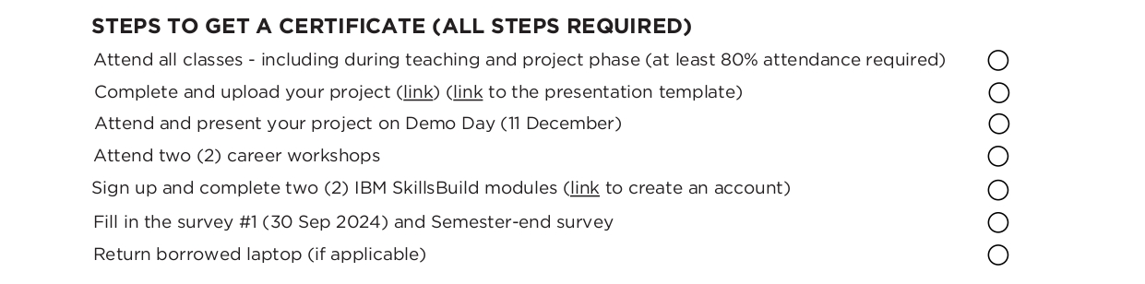
Machine Learning & AI
Sep - Dec
Commitment: 10 hrs
Time: 18:45 - 20:45
At least 80% attendance

Slide 17
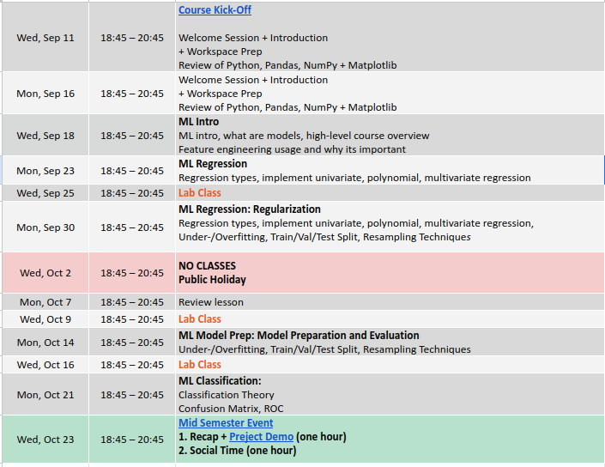

Slide 18
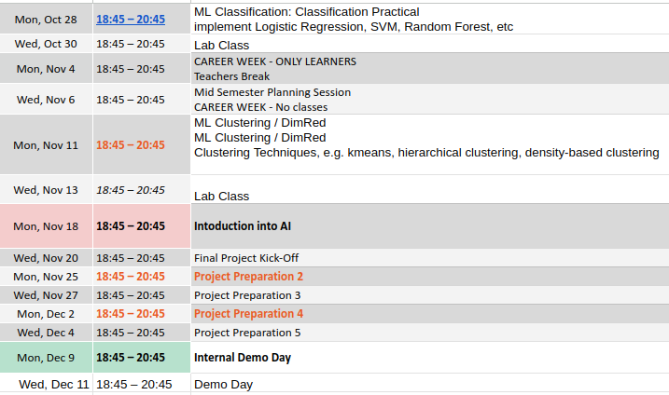

Slide 19
ML Brief Intro
Notes:
Learning goals
Learner timeline
Project phase (small mention)
Important tools
Communication
Location & format

Slide 20
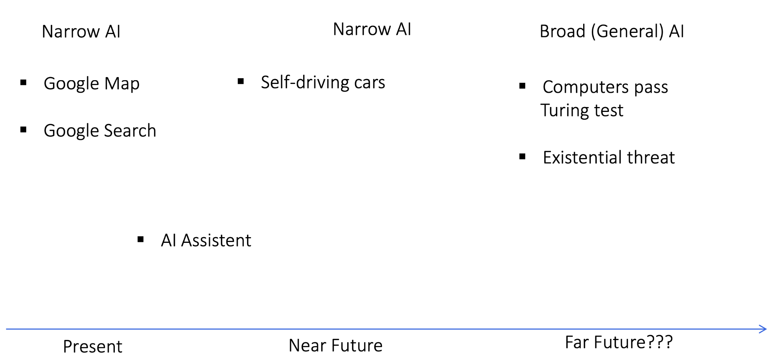
AI: Present and Future

Slide 21
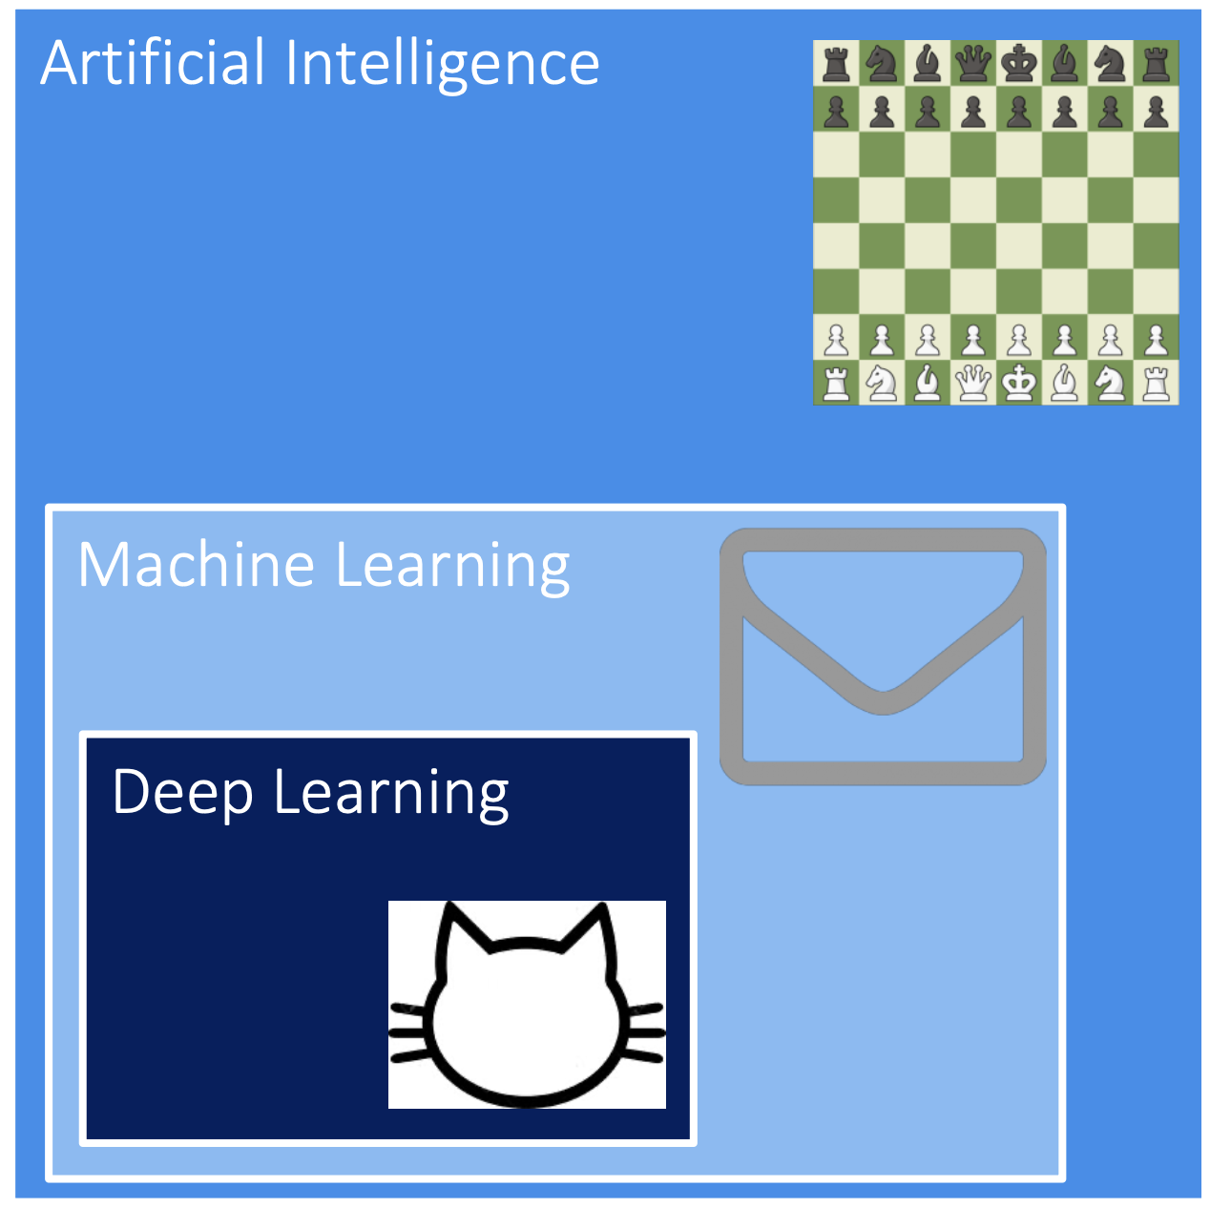
AI and their subgroups
Artificial Intelligence
broadest term
Machines adapt to different situations
Machine Learning
Statistical techniques provide computers ability to „learn“
Deep Learning
Inspired by human brain
Artificial Neural Networks (ANNs) mimic structure of the brain
Discrete layers of neurons and connections of neurons make up an ANN

Slide 22
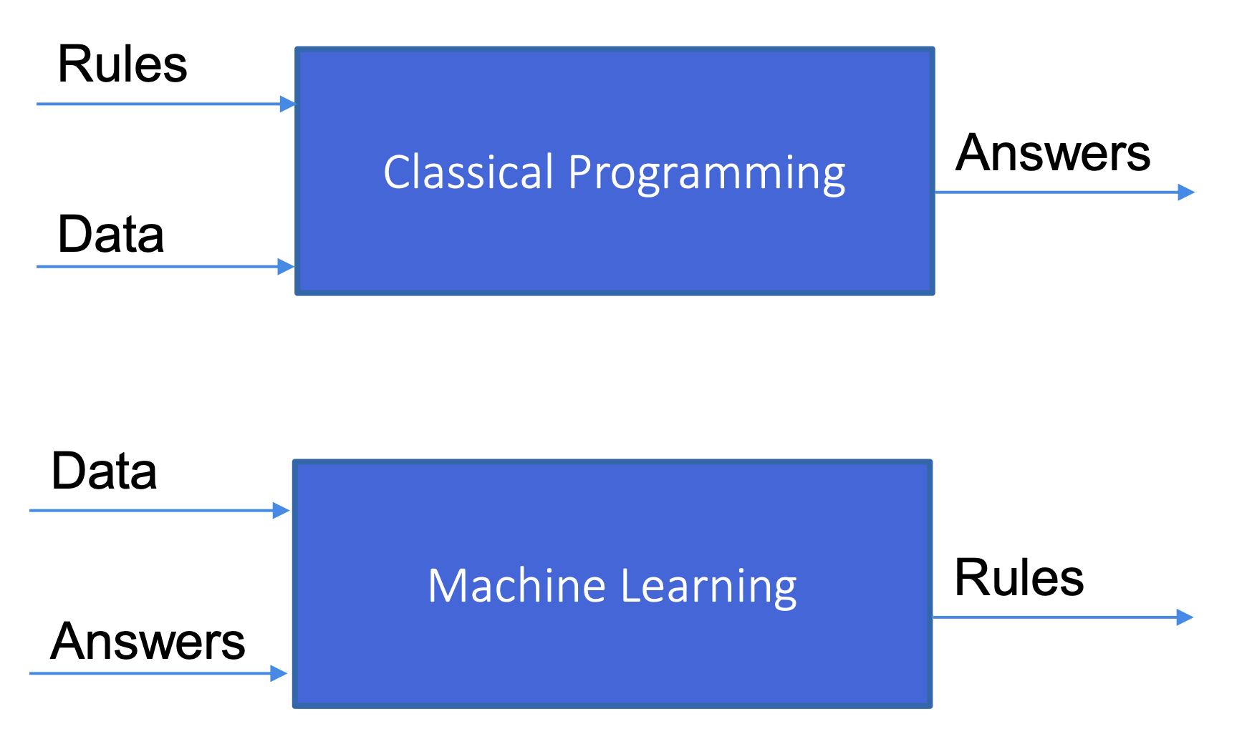
Classical Programming vs Machine Learning

Slide 23

Types of Machine Learning

Slide 24
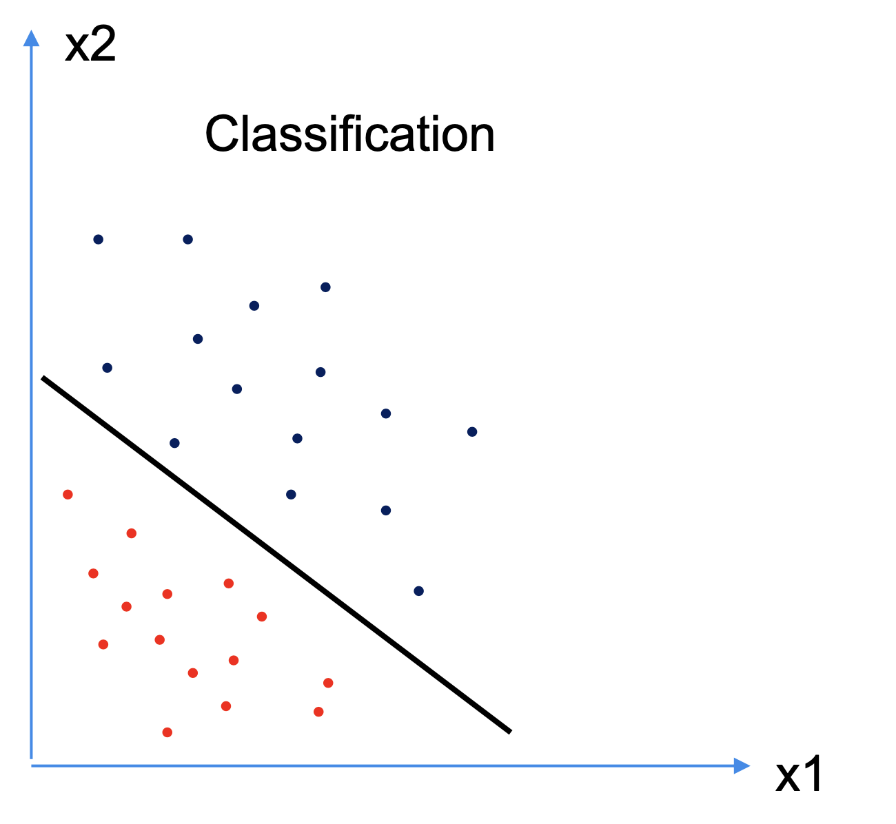
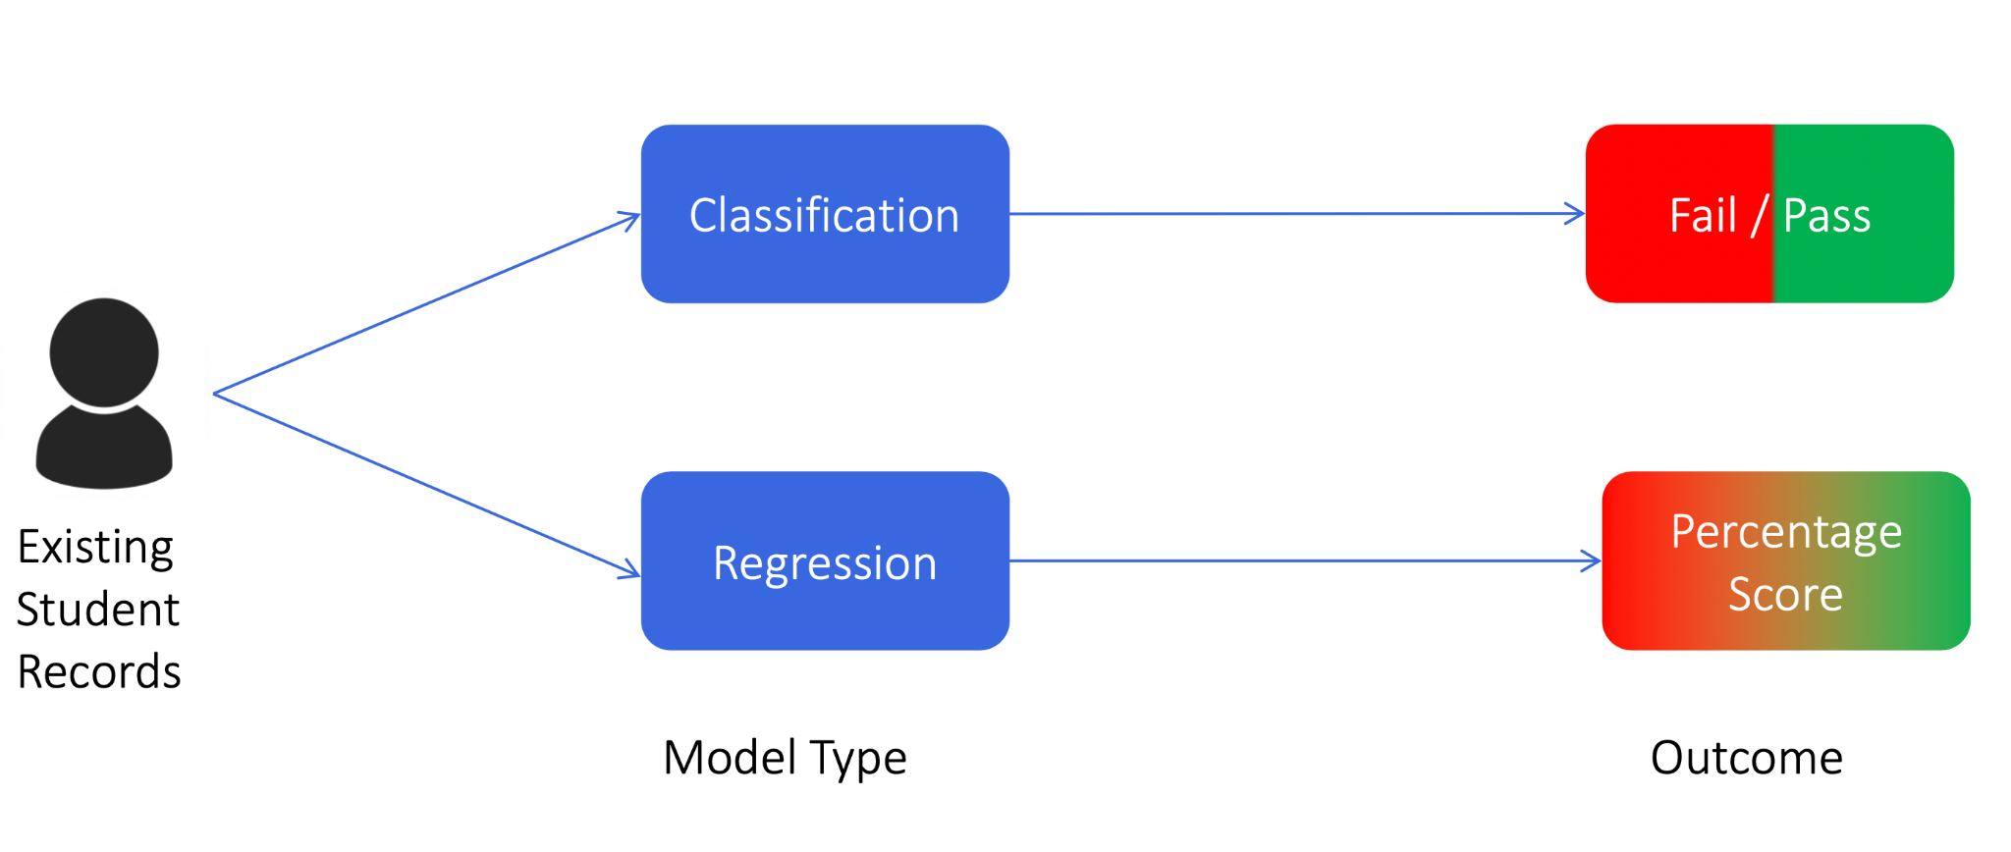
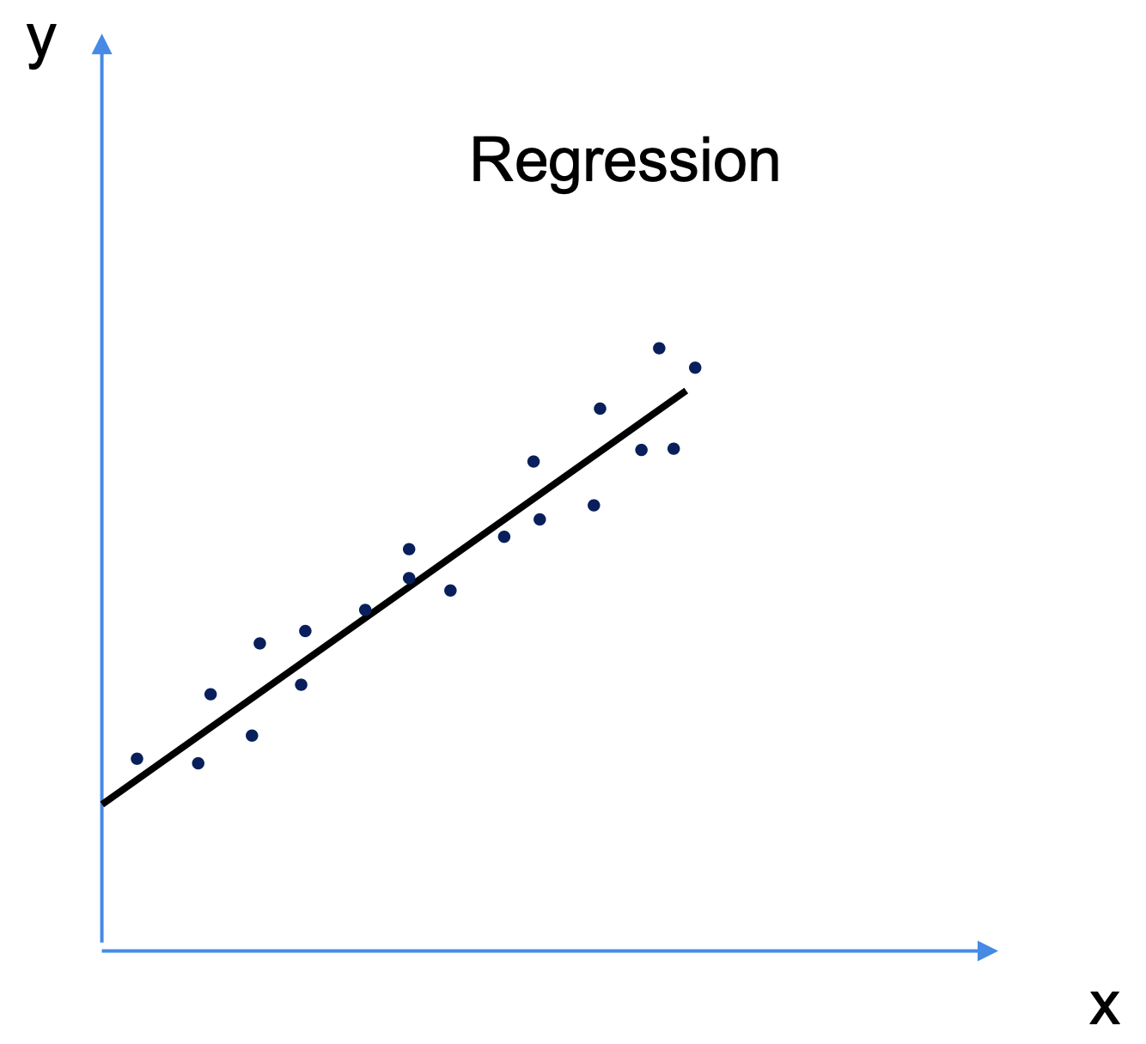
Supervised Machine Learning

Slide 25
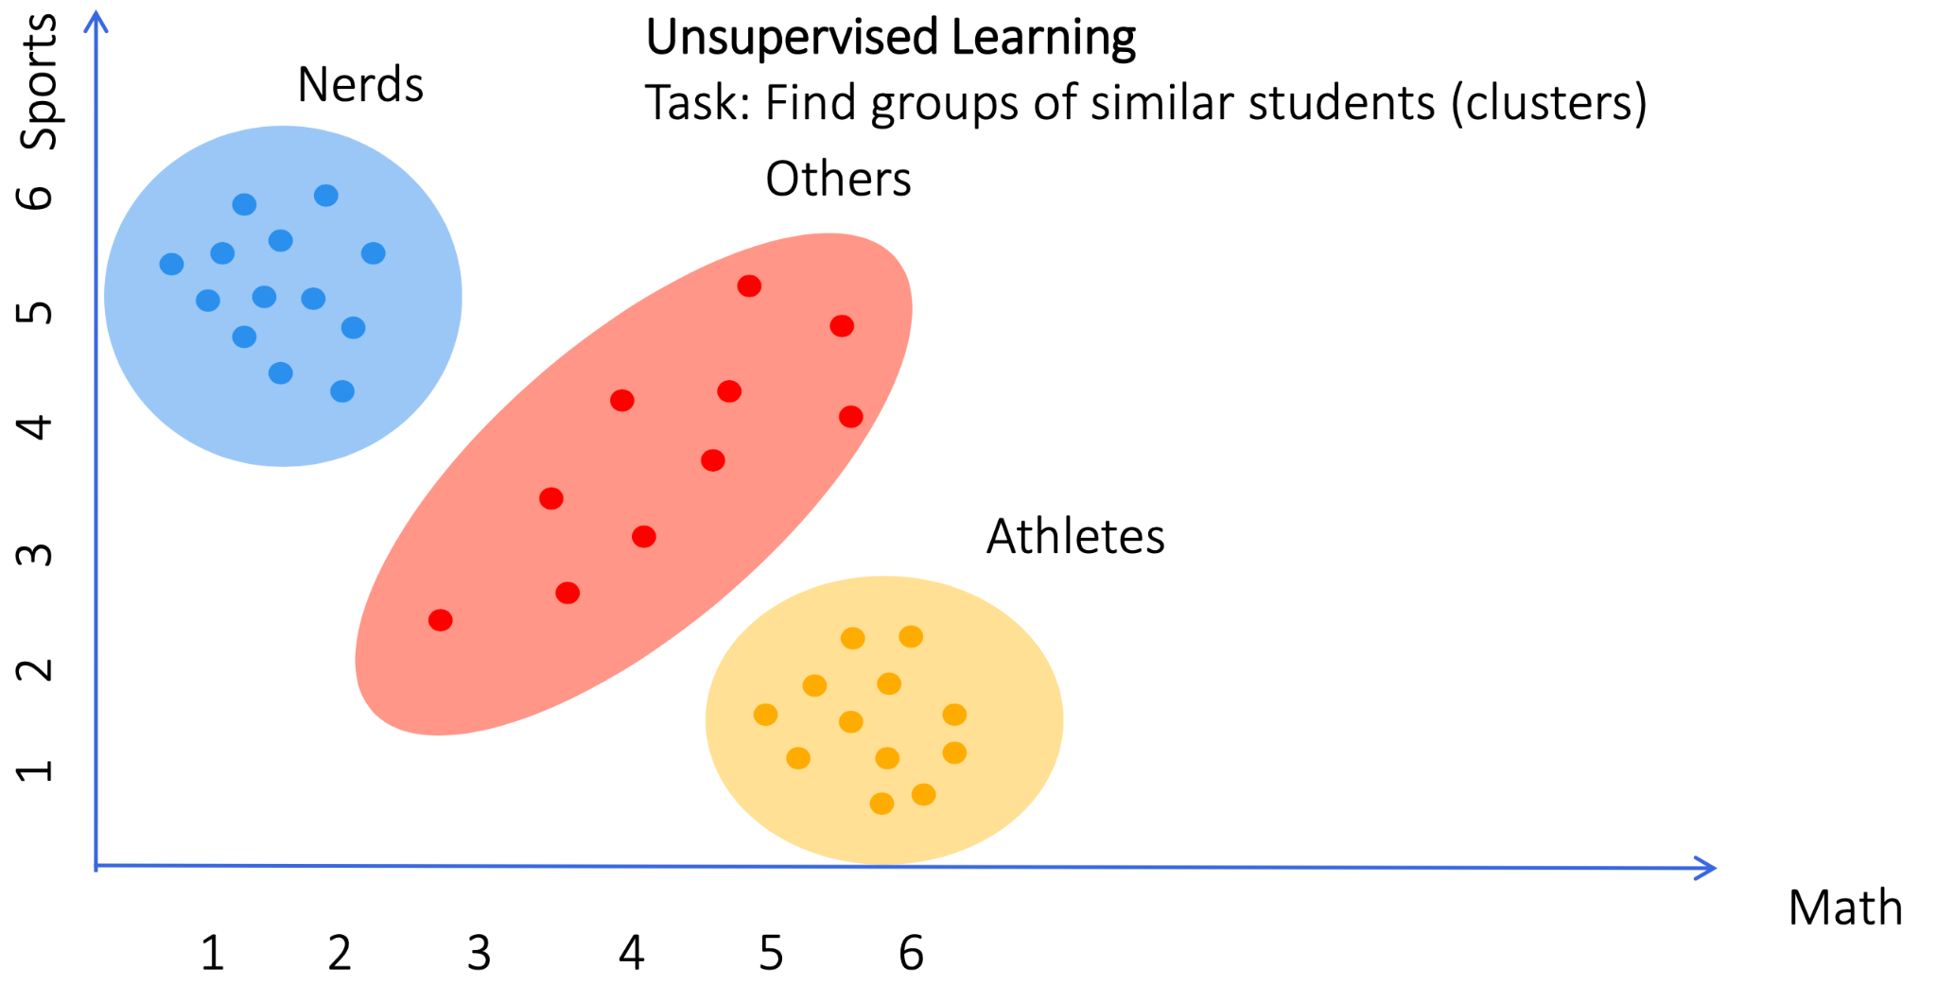
Unsupervised Machine Learning

Slide 26
Preparation/homework
for the next sessions
Notes:
Learning goals
Learner timeline
Project phase (small mention)
Important tools
Communication
Location & format

Slide 27
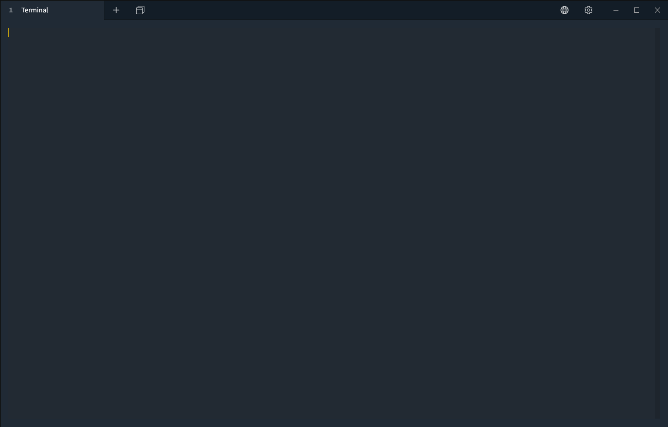
Install Python 3.10 or higher
Instructions
Downloads for Windows
Downloads for MacOS (alternative with HomeBrew)
For Linux: preferred way is to use prebuilt packages (see Linux section in instruction), but build from sources is also available
Check that all is working as expected:
➜ ~ python3 -c "import sys; print(sys.version);"
3.11.6 (main, Oct 2 2023, 13:45:54) [Clang 15.0.0 (clang-1500.0.40.1)]
➜ ~ pip3 --version
pip 23.3.1 from /opt/homebrew/lib/python3.11/site-packages/pip (python 3.11)

Slide 28
Install packages using pip package manager
We would need following libraries for the first half of the course:
Numpy
Pandas
Sklearn
Seaborn
Jupyter Notebook
To install those you need to run:
➜ ~ pip3 install numpy pandas scikit-learn seaborn jupyter
…

Slide 29
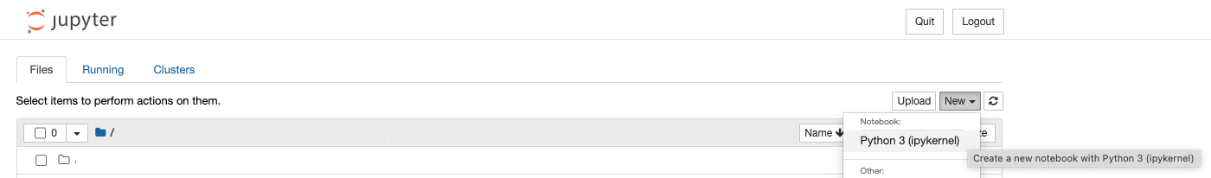
Validate packages
Run Jupyter notebook - it will open a new browser tab (or click the link)
Create a new notebook via UI
➜ ~ jupyter-notebook
…
Or copy and paste one of these URLs:
http://localhost:8888/?token=<some_token>
or http://127.0.0.1:8888/?token=<some_token>
…

Slide 30
Validate packages
Execute following imports in the very first cell of a new notebook:
import numpy as np
import pandas as pd
from sklearn.linear_model import LogisticRegression
import seaborn as sns
This should pass without any errors.

